Slide 1
Schedule source Calendar/Swap board

Slide 2
New Schedule Source Update
Your work schedules are available through Schedule Source.
Use to find a substitute for a work shift posted to the swap board.
Can be accessed at anytime through any device that has an internet connection.

Slide 3

My Calendar

Slide 4
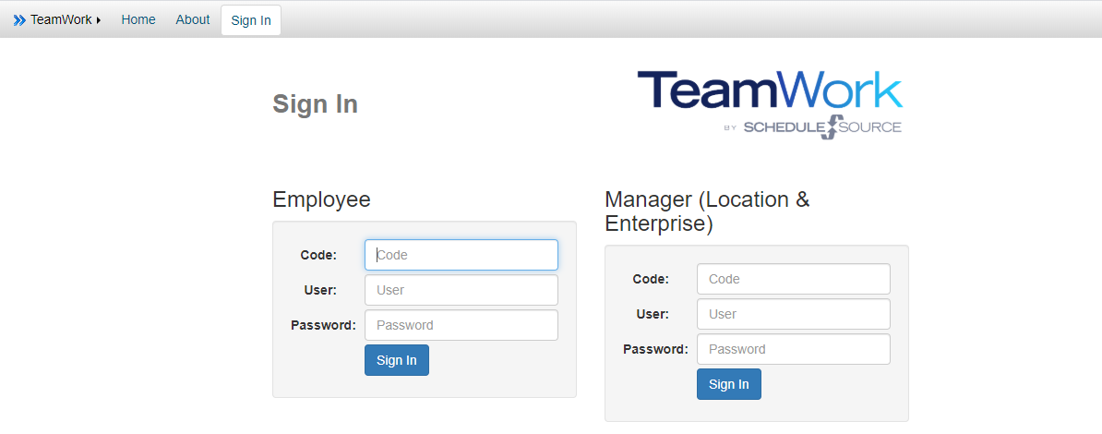
Step 1- Log on to your personal portal
Code: The location where you work
Username: Your Net ID (the first part of your ISU email address)
Password: What you used when you made your application

Slide 5
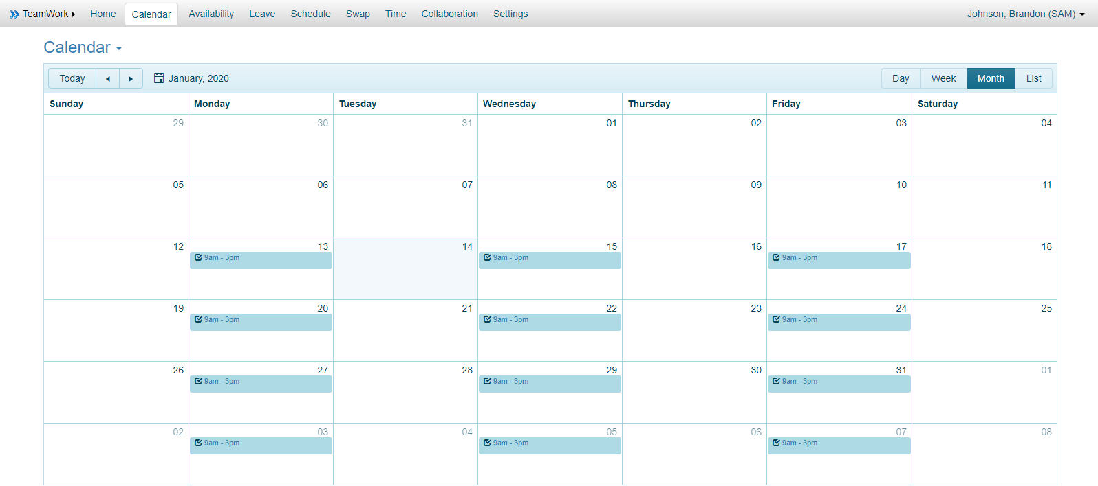
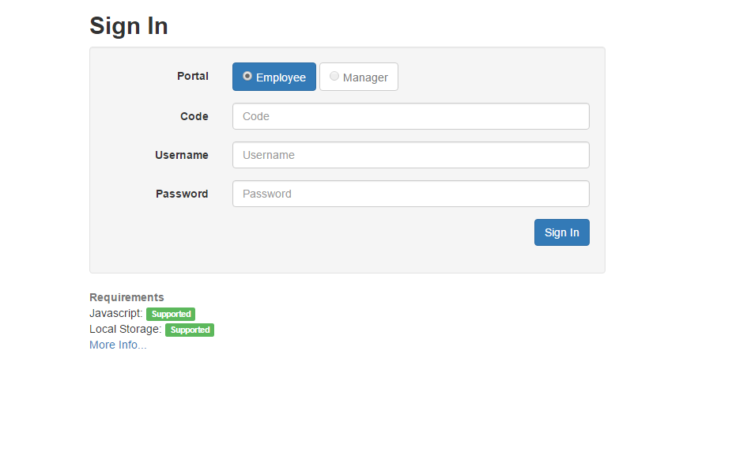
My Calendar
The landing page after logging in will be defaulted to the My Calendar. This is where you will see your schedule for the entire semester.

Slide 6

Putting a shift on the swap board
Shift

Slide 7
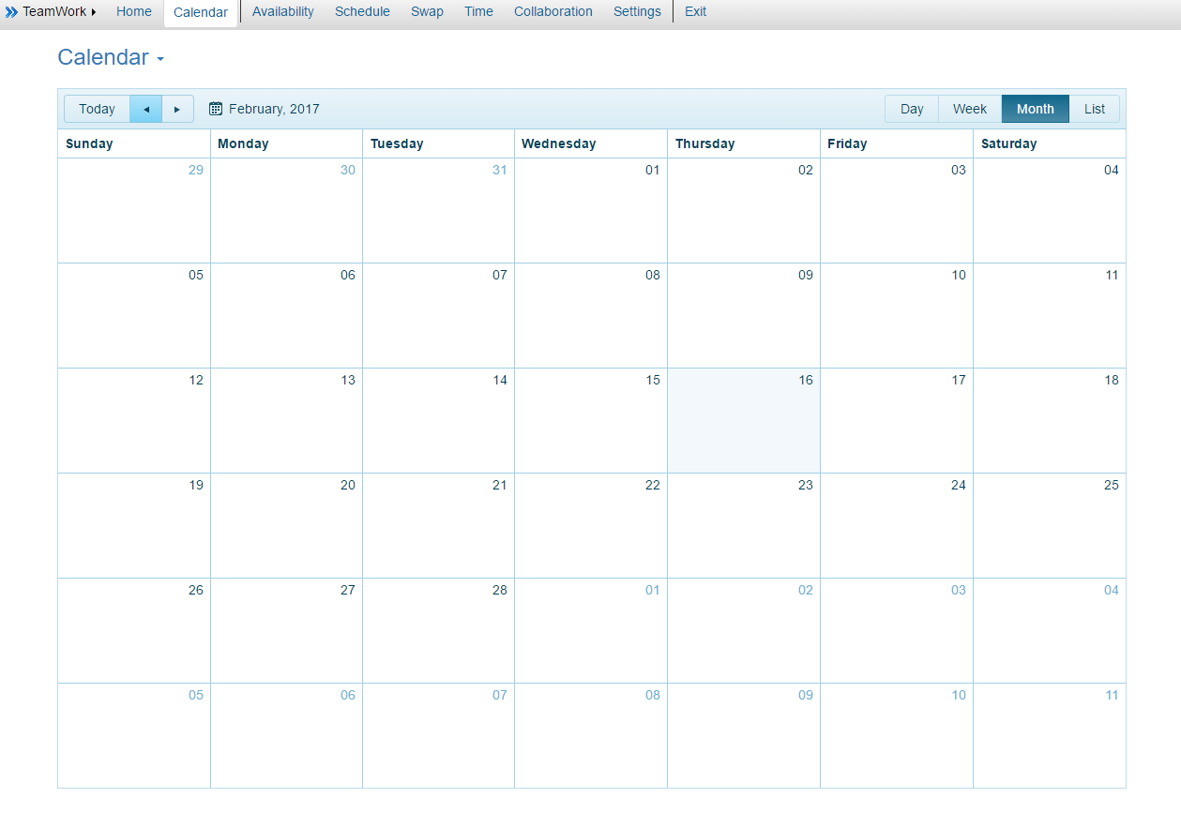
Step 1- Click on the Swap Board Tab
Once you have logged in you will be taken to your calendar. The swap tab is located in the top left middle section of the screen. Click on it to bring up the swap board.

Slide 8
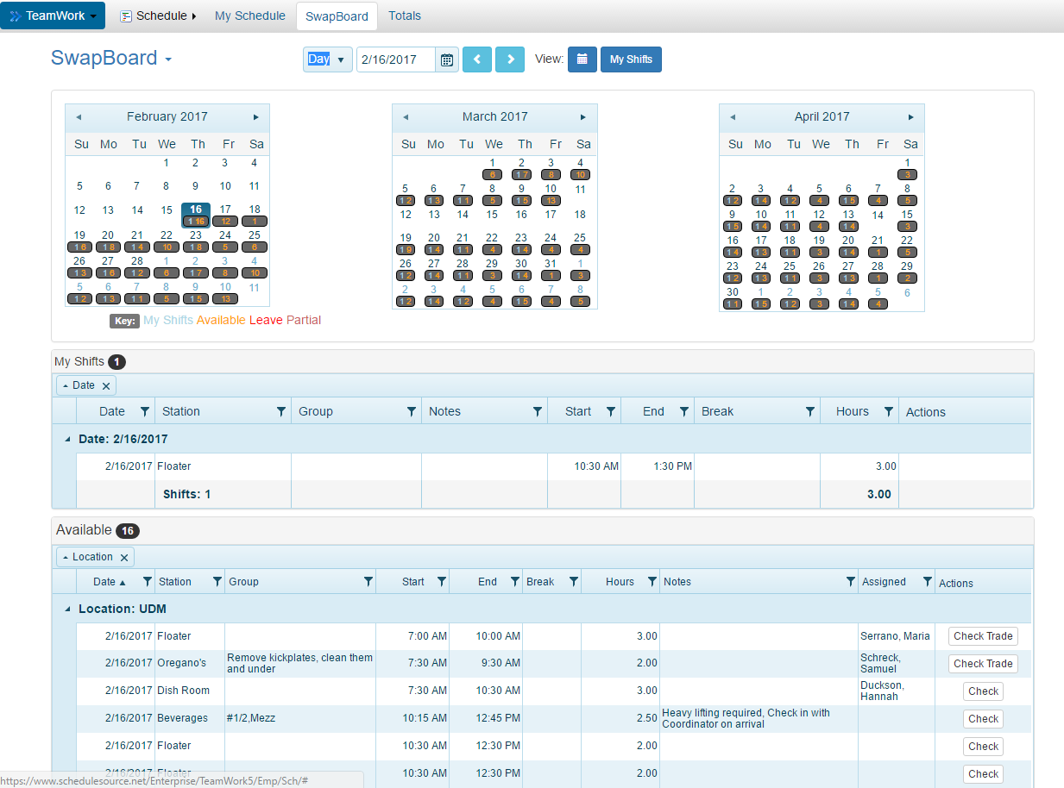
Step 2- Adding a shift to the swap board
This is the swap board page. By selecting a date from the calendar at the top of the screen, you can bring up your shifts along with shifts that are available to pick up that day.

Slide 9
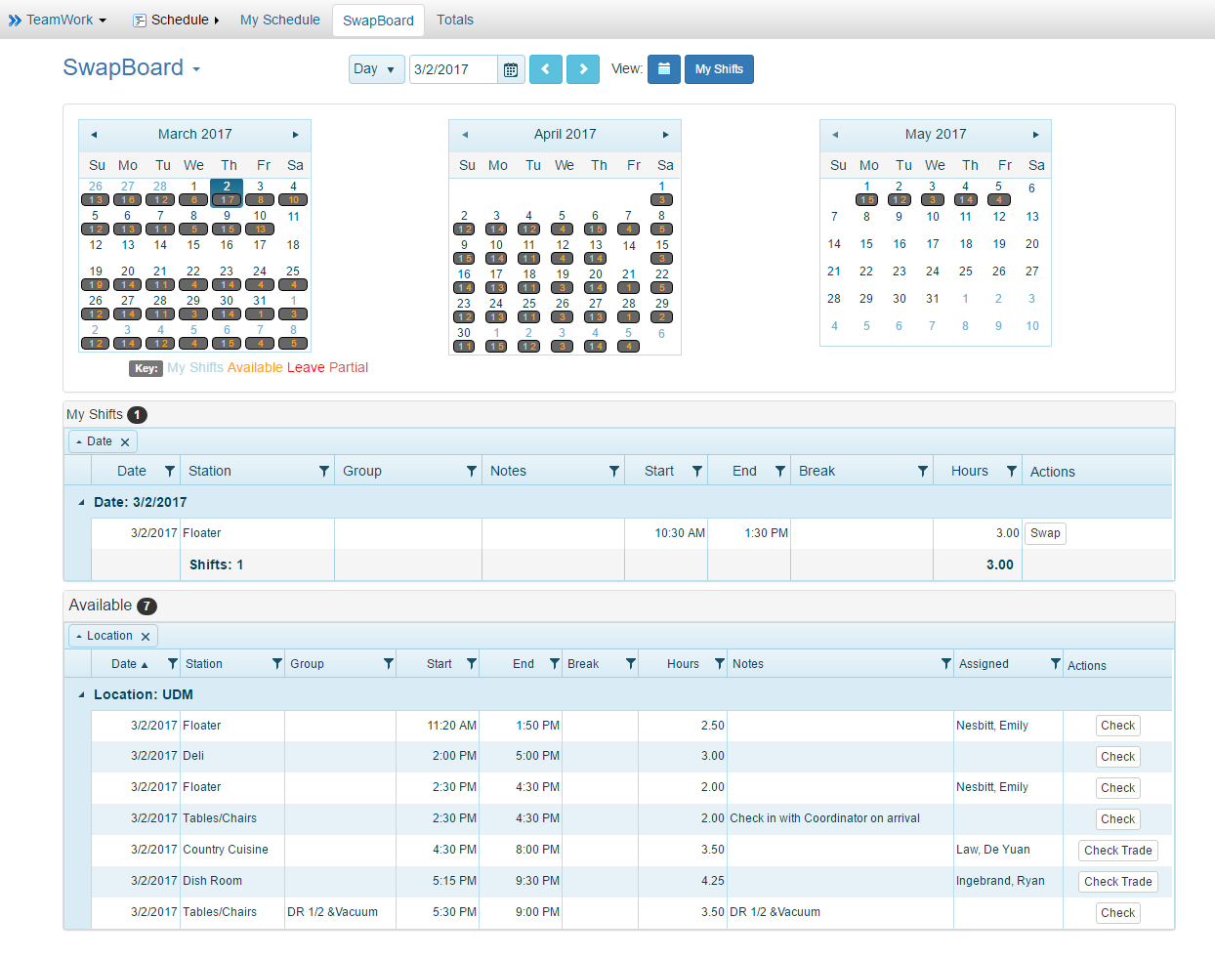
Step 2 continued…
Make sure to have the two sections with red arrows pointing at them selected. To place a shift on the swap board click on swap (its in a white box underneath the “actions” heading). Once you click on the swap button a box will appear in the middle of the screen. You will have to select a “reason” from the drop down list. Click on the “Save” button.

Slide 10

How to pick up a shift
Shift

Slide 11
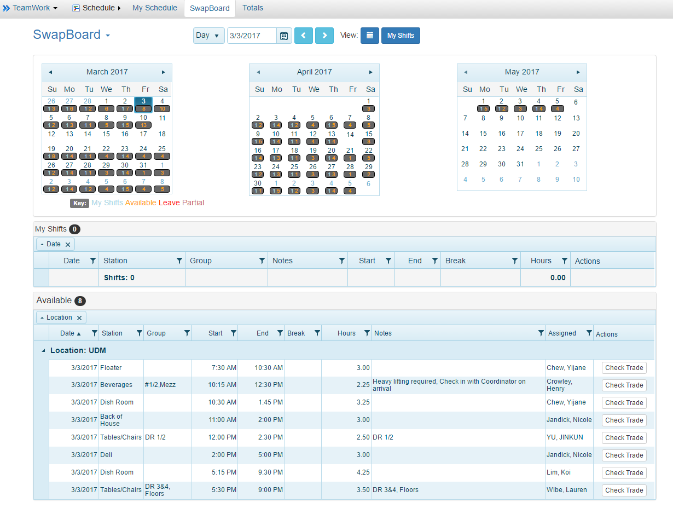
Step 1- Available shifts
The available shifts for you to pick up are listed under the “Available” heading.
To pick up a shift click on the “check” or “check trade” link under the action column.

Slide 12
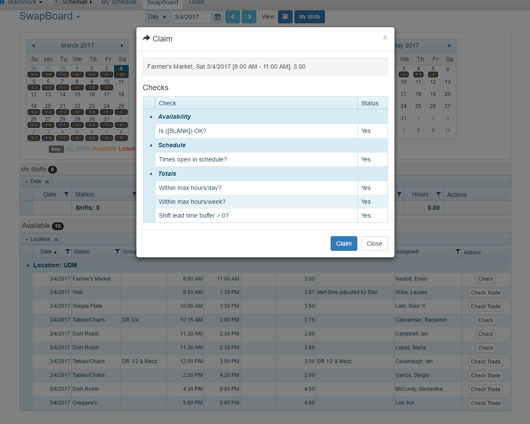
Step 2- Claiming a shift
When you click on “check”, this box will appear on your screen. If you do not have any conflicts you will be able to select the “claim” button.

Slide 13
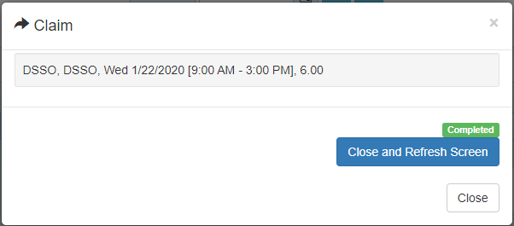
Step 2 continued…
Once you have added the shift, the box will refresh and it will say “Completed”.
You will need to click on the “close and refresh Screen” button in order to add the shift to your schedule.

Slide 14
SWAP SUCCEEDED !

